Slide 1
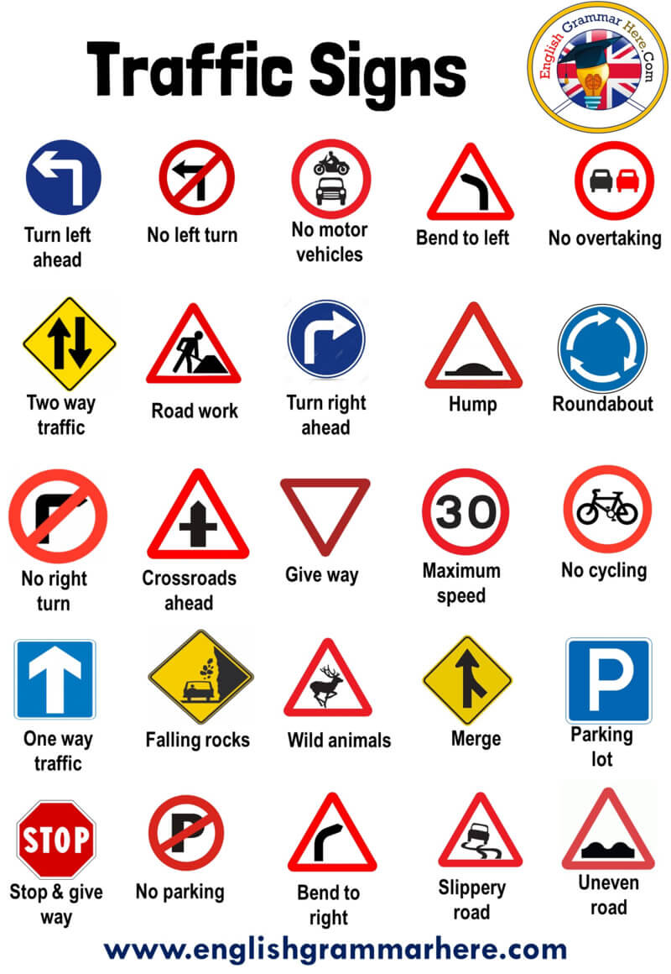
Traffic signs classification
-sarthak malik
GEEKSMAN AI SQUAD

Slide 2
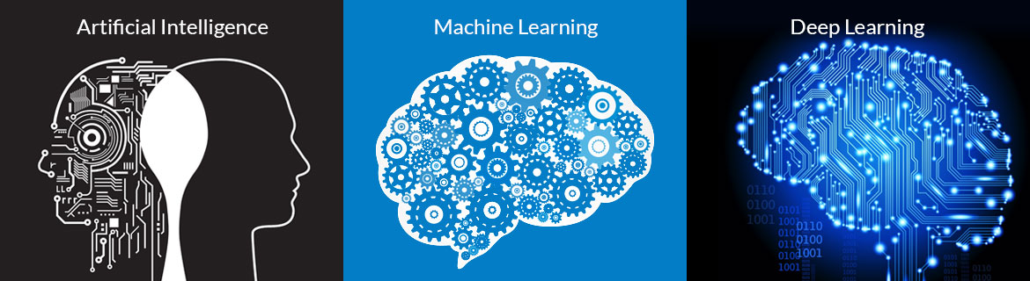
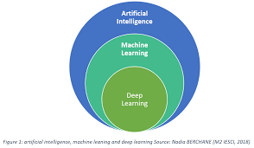
INTRODUCTION::
Machine learning (ML), a subﬁeld of artiﬁcial intelligence,has evolved out of the need to teach computers how to automatically learn a solution to a problem. In engineering this ﬁeld is referred to as pattern recognition, aptly named because the computer is extracting patterns out of data and making a decision based on the pattern identiﬁed

Slide 3
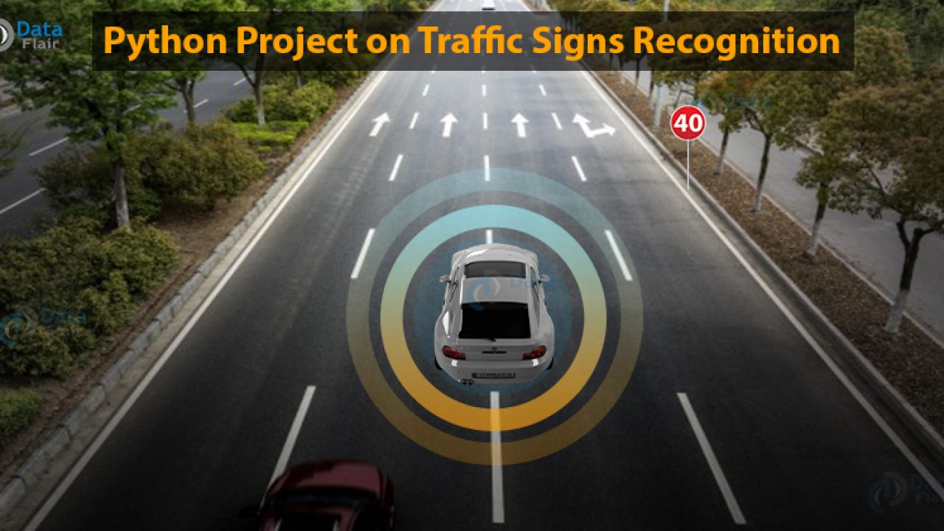
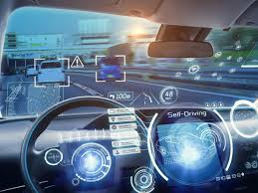
PROJECT- TRAFFIC SIGN CLASSIFICATION
I have developed a platform for exposing the drivers to machine learning techniques for traffic sign classification.With this platform I have created mainly for the drivers as well as for the driverless cars(which is our main moto).This project is able to classify between different sign symols.

Slide 4
OVERVIEW OF THE DATASET
Speed limit (20km/h)
Speed limit (30km/h)
Speed limit (50km/h)
Speed limit (60km/h)
Speed limit (70km/h)
Speed limit (80km/h)
End of speed limit (80km/h)
Speed limit (100km/h)
Speed limit (120km/h)
No passing
No passing for vechiles over 3.5 metric tons
Right-of-way at the next intersection
Priority road
Yield
Stop
No vechiles
Vechiles over 3.5 metric tons prohibited
No entry
General caution
I took the dataset from the https://www.kaggle.com and then precise it.
The dataset has 19 different categories containing 500 different images each.
My dataset is capable in finding 19 different sign boards.
The main moto is that may of us didn’t know the exact meaning of he traffic signs due to which we come in a trouble like a challan or even a big accident too.

Slide 5
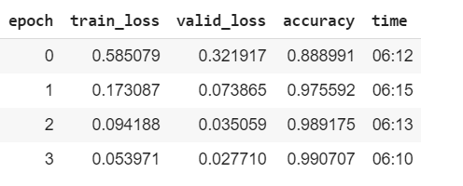
ACCURACY:
The traffic design project gives the accuracy of 99.07% by training the dataset 4 times.
The training is done by the help of resnet 50.

Slide 6
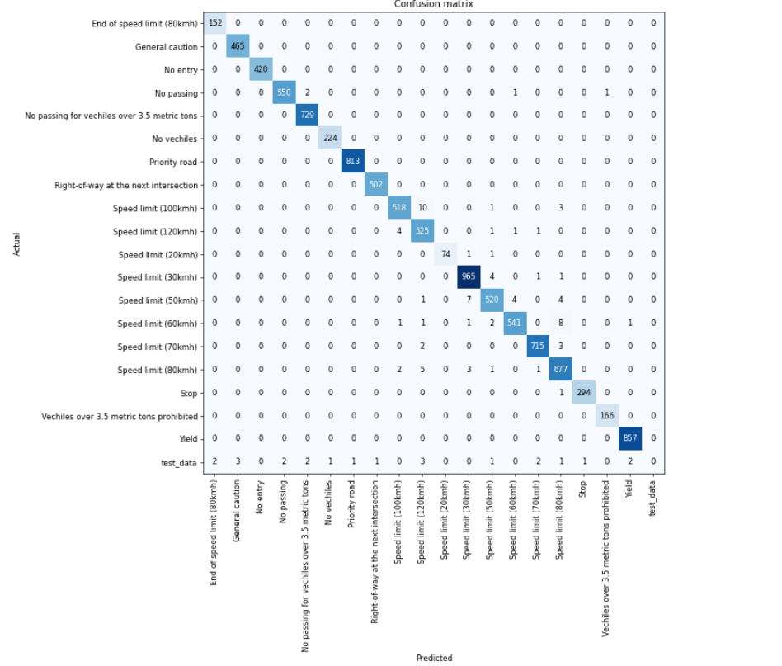

Slide 7

CONCLUSION
The experiment was successful in studying the specific effects of different influence factors and the evaluation model of guide sign recognition with a convenience sample of drivers.

Slide 8

BIBLIOGRAPHY
I took the dataset from the kaggle.
I thank to the GEEKSMAN AI SQUAD and our mentor Sir Trilok Kaushik for their support.

Slide 9
INTRODUCTION:
NAME- SARTHAK MALIK
BRANCH- CS (ML)
Member of GEEKSMAN AI SQUAD
University- Graphic Era Deemed to
be University

Slide 10


